Slide 1
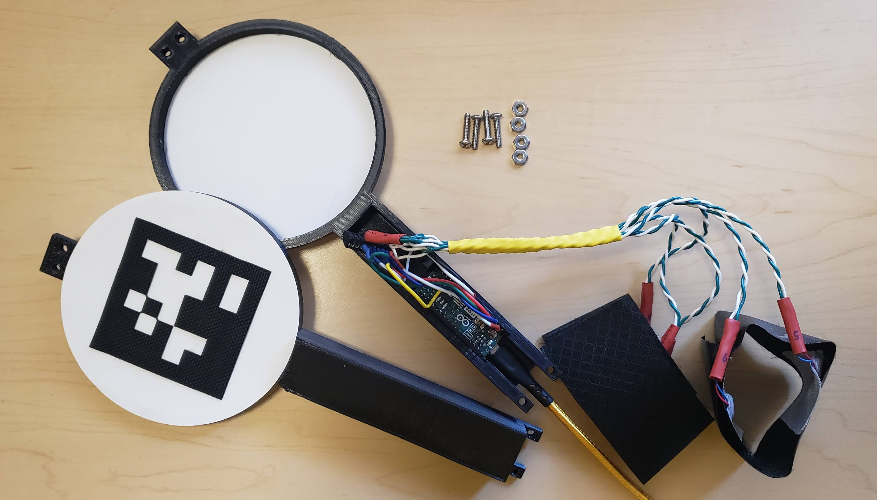
Screw terminal for motor connections
Wristbands, with
2 vibration motors each
Arduino Micro
AprilTag
3D Printed Chassis

Slide 2
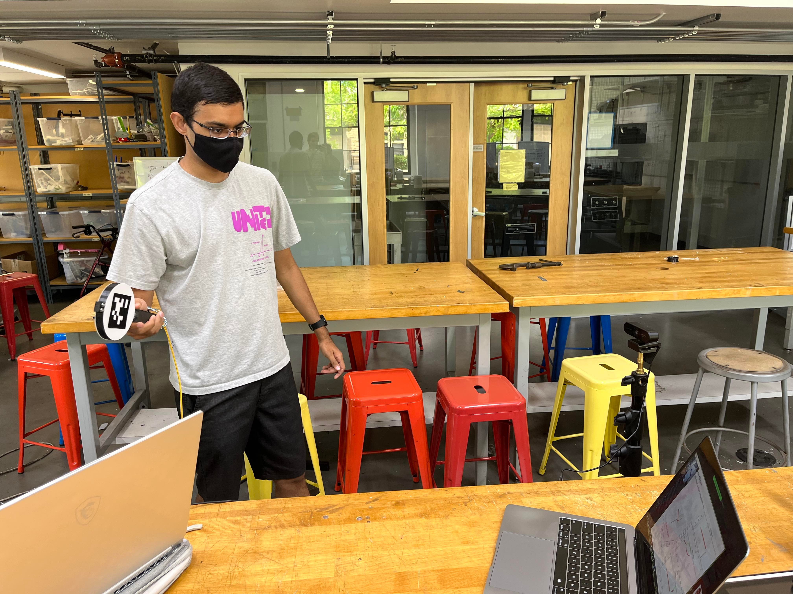
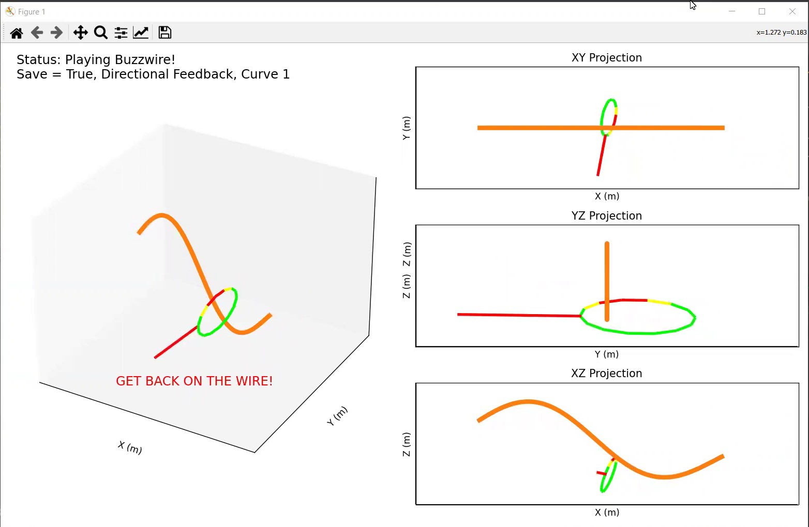
(a)
(b)
AR Tag
Camera
Visual Interface

